Slide 1

HISTORY OF THE EMERGENCE OF INDEPENDENT BANGLADESH
Dr. Md. Abdul Alim
B. A (Hon’s), M. A (History), M. Phil (Raj), Ph. D (Raj)
Email:doctorabdulalim64@gmail.com
Cell: +880 01718-787466

Slide 2
BACKGROUND OF LANGUAGE MOVEMENT - 1952
From the mid-19th century, the Urdu language had been promoted as the lingua franca of Indian Muslim by political and religious leaders, Urdu is a Central Indo-Aryan language of the Indo-Iranion branch, closely related to Hindi and belonging to the Indo-European family of languages. It developed under Persian, Arabic and Turkic influence in South Asia during the Delhi Sultanate and Mughal Empire. With its Perso-Arabic script, the language was considered a vital element of the Islamic culture for Indian Muslims.
While the use of Urdu grew common with Muslims in northern India, the Muslims of Bengal primarily used the Bengali language. Bengali is an Eastern-Aryan language that arose from the eastern Middle Indic Language around 1000 CE and developed considerably during the Bengal Renaissance. As early as the late 19th century, social activists such as the Muslim feminist Roquia Sakhwat Hussain were choosing to write in Bengali to reach out to the people and develop it as a modern literary language.

Slide 3
EARLY STAGES OF THE MOVEMENT
Britain's holdings on the Indian subcontinent were granted independence in 1947 and 1948, becoming four new independent states: the Dominion of India, the Union of Burma (now Myanmar), the Dominion of Ceylon (now Sri Lanka), and the Dominion of Pakistan.
After the partition of India in 1947, Bengali-speaking people in East Bengal, made up 44 million of the newly formed Dominion of Pakistan's 69 million people.
The Dominion of Pakistan's government, civil services, and military, however, was dominated by personnel from the western wing of the Dominion of Pakistan.

Slide 4
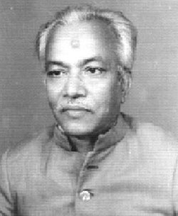
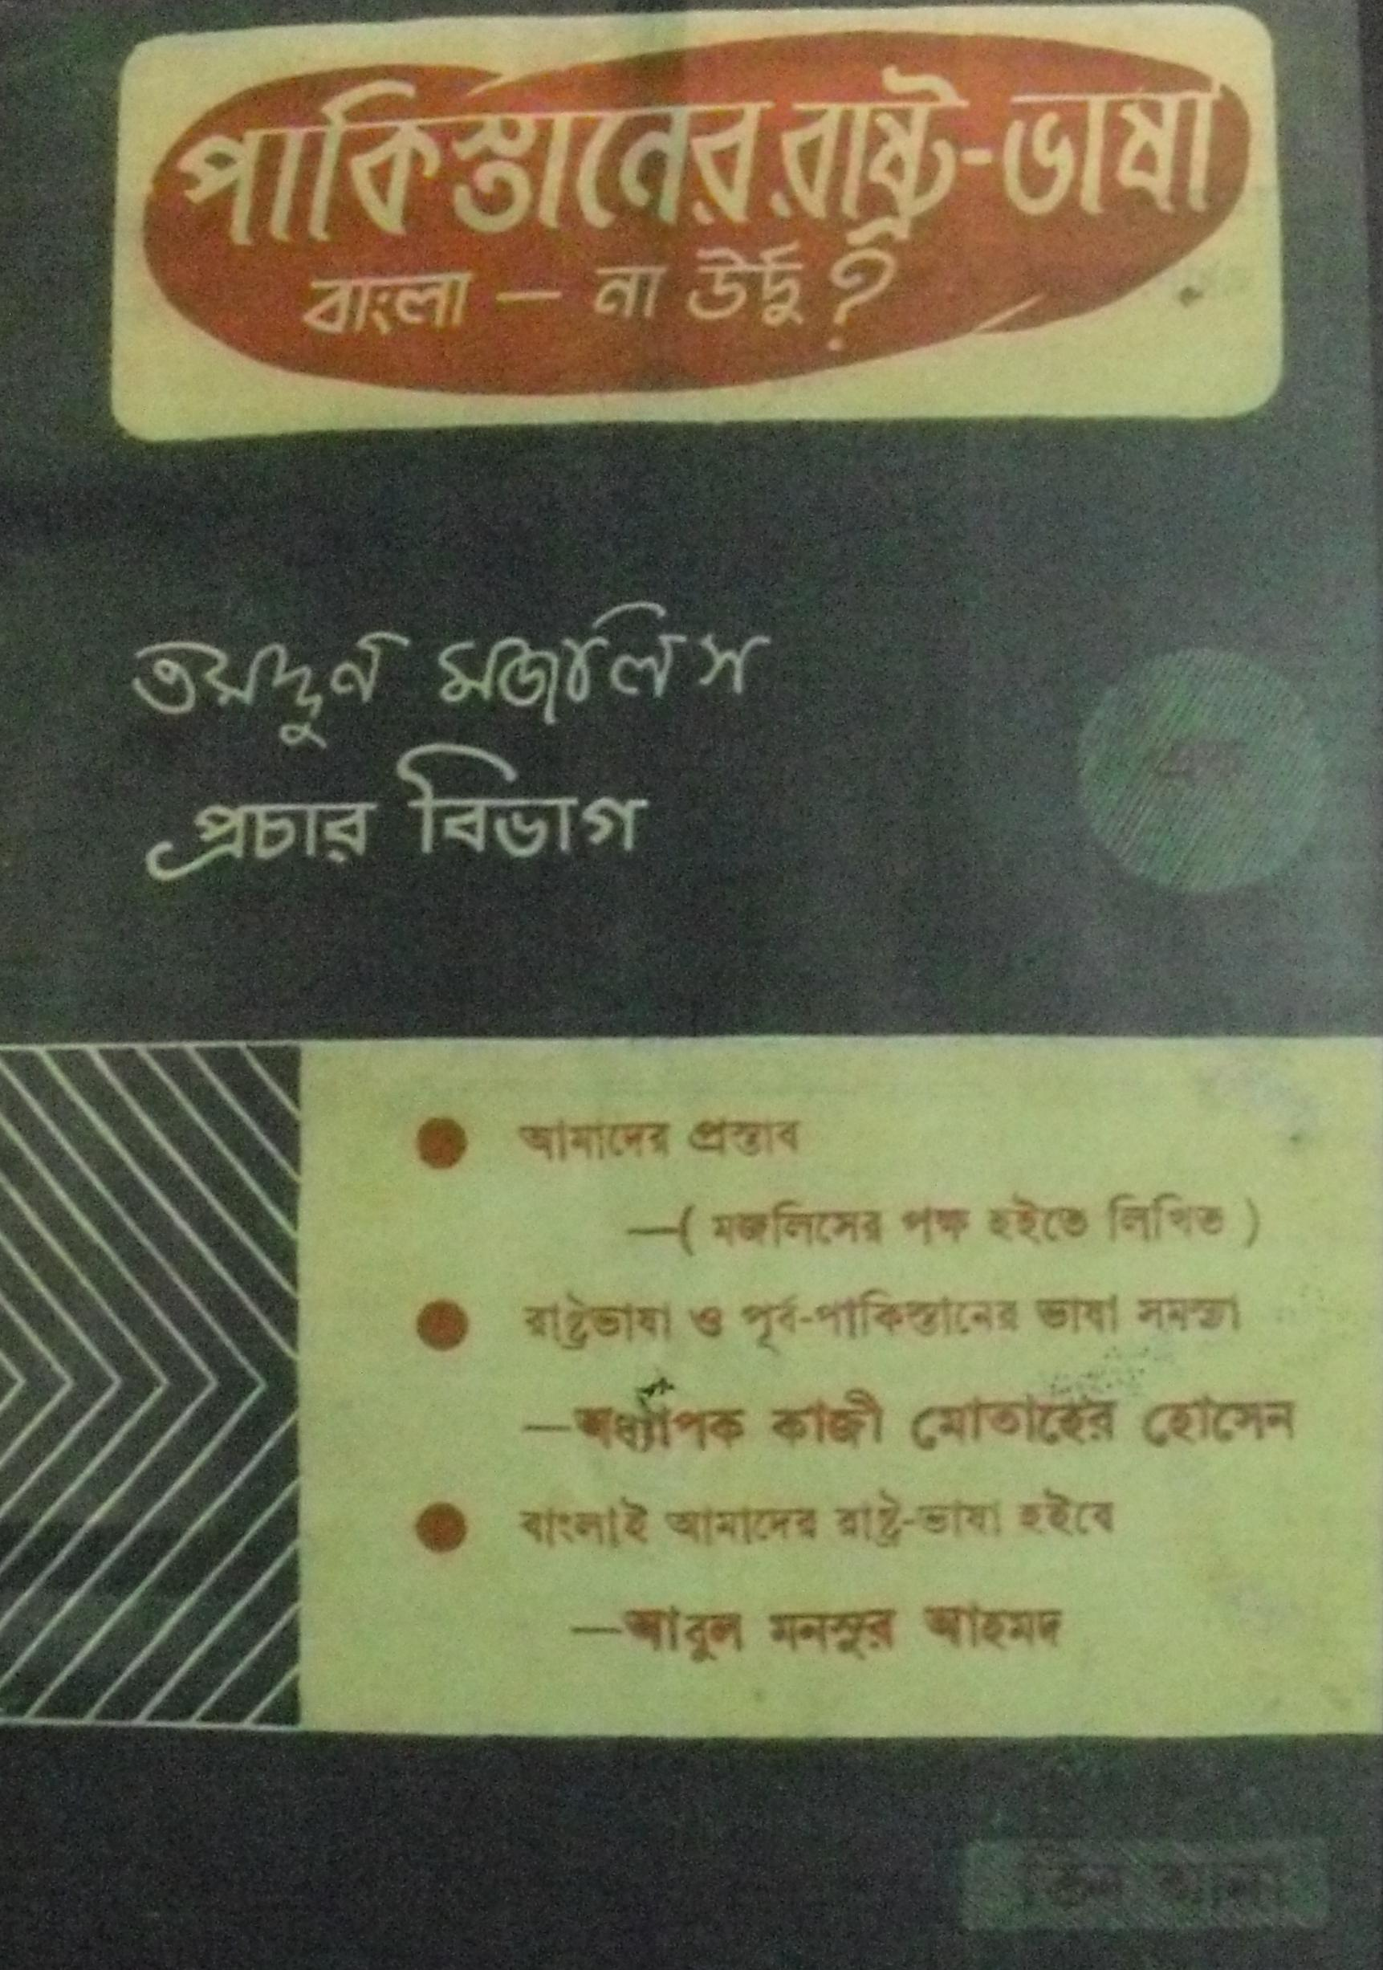
EARLY STAGES OF THE MOVEMENT
In November 1947, a key resolution at a national education summit in Karachi advocated Urdu and English as the sole state languages. Students from Dhaka rallied under the leadership of Abul Kashem, the secretary of Tamaddun Mujlish, a Bengali Islamic cultural organisation. The meeting stipulated Bengali as an official language of the Dominion of Pakistan and as a medium of education in East Bengal.

Slide 5
EARLY STAGES OF THE MOVEMENT
However, the Pakistan Public Service Commission removed Bengali from the list of approved subjects, as well as from currency notes and stamps. The central education minister Fazlur Rahman made extensive preparations to make Urdu the only state language of the Dominion of Pakistan.
Public outrage spread, and many Bengali students met on the University of Dhaka campus on 8 December 1947 to formally demand that Bengali be made an official language. To promote their cause, Bengali students organised processions and rallies in Dhaka.

Slide 6
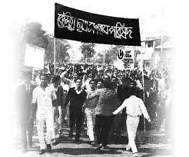
EARLY STAGES OF THE MOVEMENT
The first Rastrabhasa Sangram Parished (National Language Action Committee), an organisation in favour of Bengali as a state language was formed towards the end of December 1947. Professor Nurul Haq Bhuiyan of the Tamaddun Majlish convened the committee. Later, Parliament member Shamsul Huq convened a new committee to push for Bengali as a state language

Slide 7
EARLY STAGES OF THE MOVEMENT
Assembly member Dhirendranath Datta proposed legislation in the Constitute Assembly of Pakistan to allow members to speak in Bengali and authorize its use for official purposes. Datta's proposal was supported by legislators Prem Hari Burman, Bhupendra Kumer Datta and Sris Chandra Chattaopadhyaya of East Bengal, as well as the people from the region.
Prime minister Liaquat Ali Khan and the Muslim League denounced the proposal as an attempt to divide the Pakistani people.

Slide 8
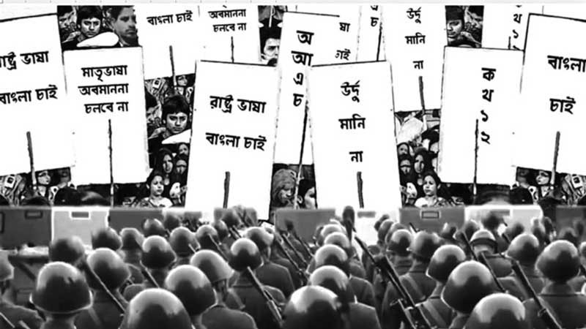
AGITATIONS OF 1948
Students of the University of Dhaka and other colleges of the city organized a general strike on 11 March 1948 to protest the omission of the Bengali language from official use, including coins, stamps and recruitment tests for the navy.
The objective of the movement was to declare the Bengali would be an official language of the Dominion of Pakistan. Political leaders such as Shamsul Huq, Shawkat Ali, M Sirajul Islam, Kazi Golam Mahboob, Oli Ahad, Abdul Wahed and others were arrested during the rallies. Rally leader Mohammad Toaha was hospitalised after attempting to snatch a rifle from a police officer. Student leaders, including Abdul Matin and Abdul Malek Ukil took part in the procession.

Slide 9
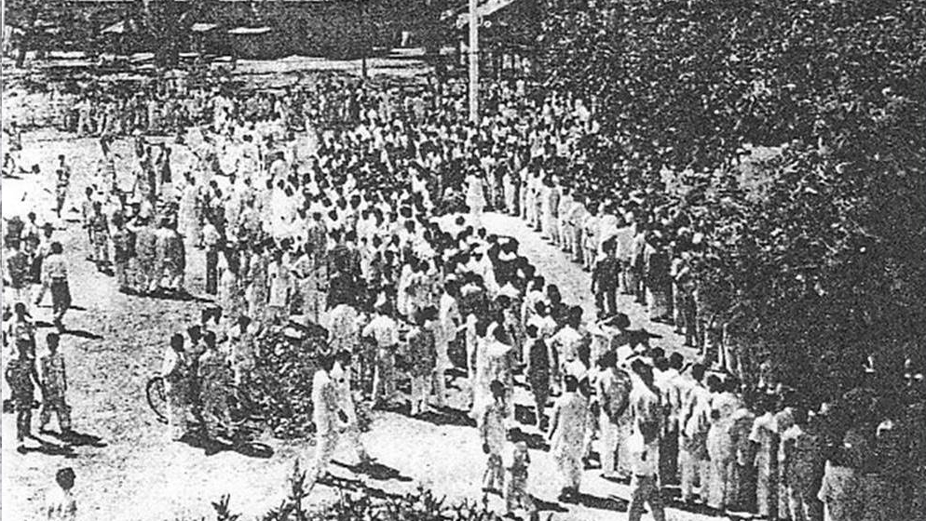
AGITATIONS OF 1948
On the afternoon of 11 March, a meeting was held to protest police brutality and arrests. A group of students marching toward chief minister Khawaja Nazimuddin's house was stopped in front of the Dhaka High Court. The rally changed its direction and moved in the direction of the Secretariat building. Police attacked the procession injuring several students and leaders, including A. K. Fazlul Huq. Continuing strikes were observed the following four days. Under such circumstances, the chief minister Nazimuddin signed an accord with the student leaders agreeing to some terms and conditions without complying with the demand that Bengali be made a state language.

Slide 10
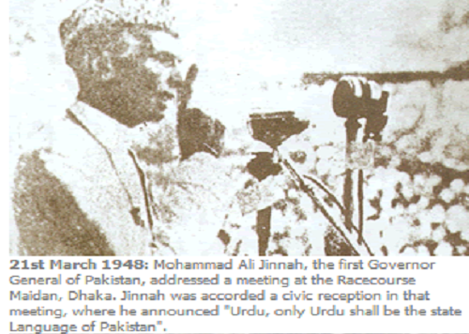
GOVERNOR-GENERAL OF PAKISTAN MUHAMMAD ALI ZINNAH’S DECLARATION
In the height of civic unrest, Governor-General of Pakistan Muhammad Ali Zinnah arrived in Dhaka on 19 March 1948. On 21 March, at a civic reception at Rescourse Ground, he claimed that the language issue was designed by a "fifth column" to divide Pakistani Muslims. Jinnah further declared that "Urdu, and only Urdu" embodied the spirit of Muslim nations and would remain as the state language, those who disagreed with his views as "Enemies of Pakistan".
Jinnah delivered a similar speech at Curzon Hall of the University of Dhaka on 24 March. At both meetings, Jinnah was interrupted by large segments of the audience. He later called a meeting of a state language committee of action, and overruled the contract that was signed by Khawaja Nazimuddin with the student leaders. Before Jinnah left Dhaka on 28 March, he delivered a speech on radio repeating his "Urdu-only" policy.

Slide 11
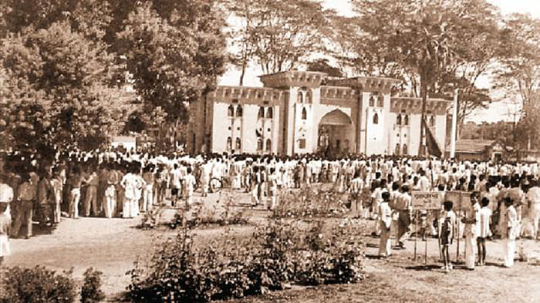
EVENTS OF 1952
The Urdu-Bengali controversy was reignited when Jinnah's successor, governor-general Khawaja Nazimuddin, defended the "Urdu-only" policy in a speech on 27 January 1952.
On 31 January, the Shorbodolio Kendrio Rashtrobhasha Kormi Porished (All-Party Central Language Action Committee) was formed in a meeting at the Bar Library Hall of the University of Dhaka, chaired by Maulana Bhashani.

Slide 12
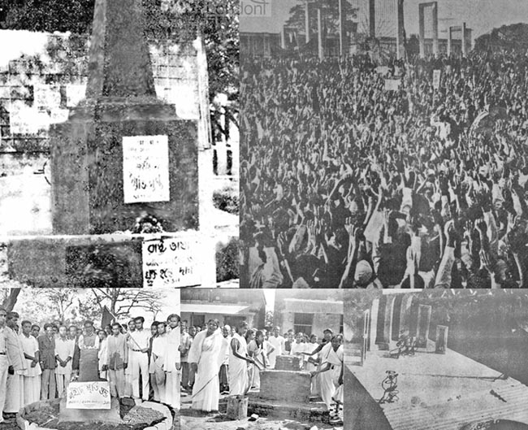
EVENTS OF 1952
The central government's proposal of writing the Bengali language in Arabic script by East Pakistan's education secretary Fazlur Rahman was opposed at the meeting. The action committee called for an all-out protest on 21 February, including strikes and rallies. In an attempt to prevent the demonstration, the government-imposed Section 144 in Dhaka, thereby banning any gathering.

Slide 13
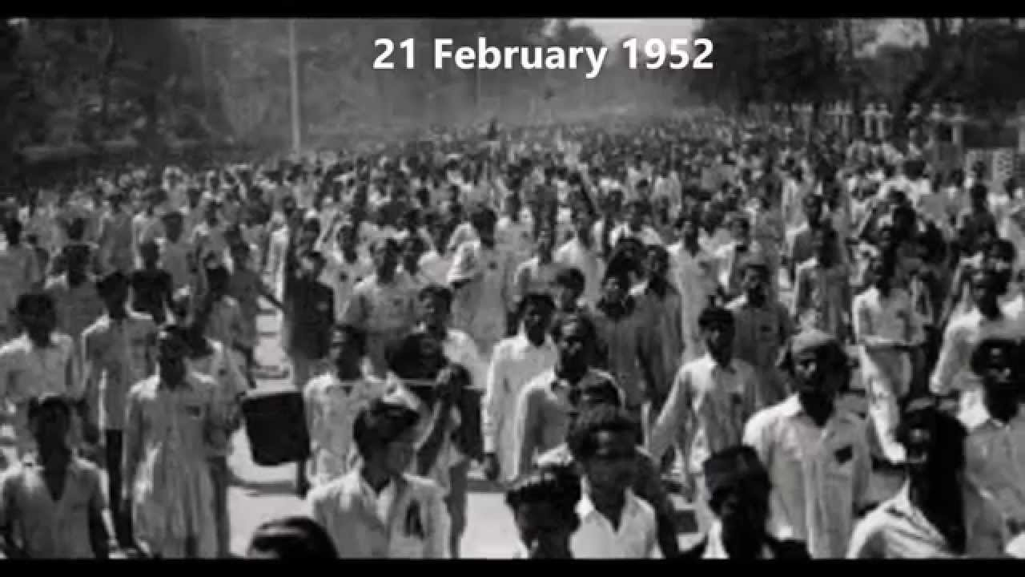
21 FEBRUARY 1952
At nine o'clock in the morning, students began gathering on the University of Dhaka premises in defiance of Section 144. The university vice-chancellor and other officials were present as armed police surrounded the campus.
By a quarter past eleven, students gathered at the university gate and attempted to break the police line. Police fired tear gas shells toward the gate to warn the students.
A section of students ran into the Dhaka Medical College while others rallied towards the university premises cordoned by the police. The vice-chancellor asked police to stop firing and ordered the students to leave the area.

Slide 14
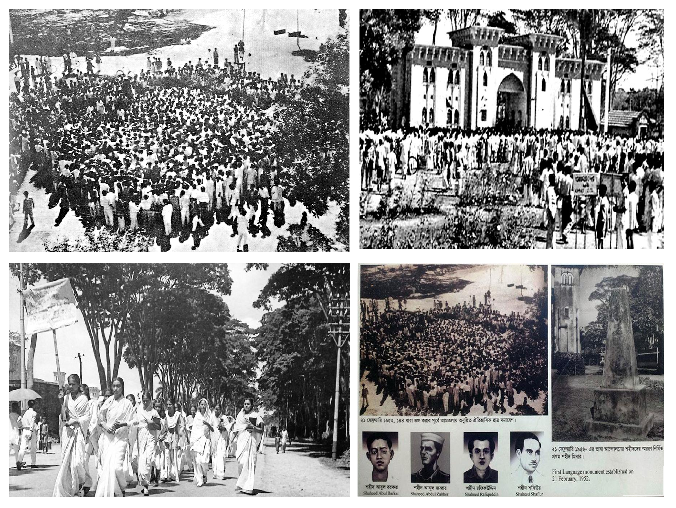
21 FEBRUARY 1952
However, the police arrested several students for violating section 144 as they attempted to leave. Enraged by the arrests, the students met around the East Bengal Legislative Assembly and blocked the legislators' way, asking them to present their insistence at the assembly.
When a group of students sought to storm into the building, police opened fire and killed a number of students, including Abdus Salam, Rafiq Uddin, Sofiur Rahman, Abul Barkat and Abdul Jabbar.

Slide 15
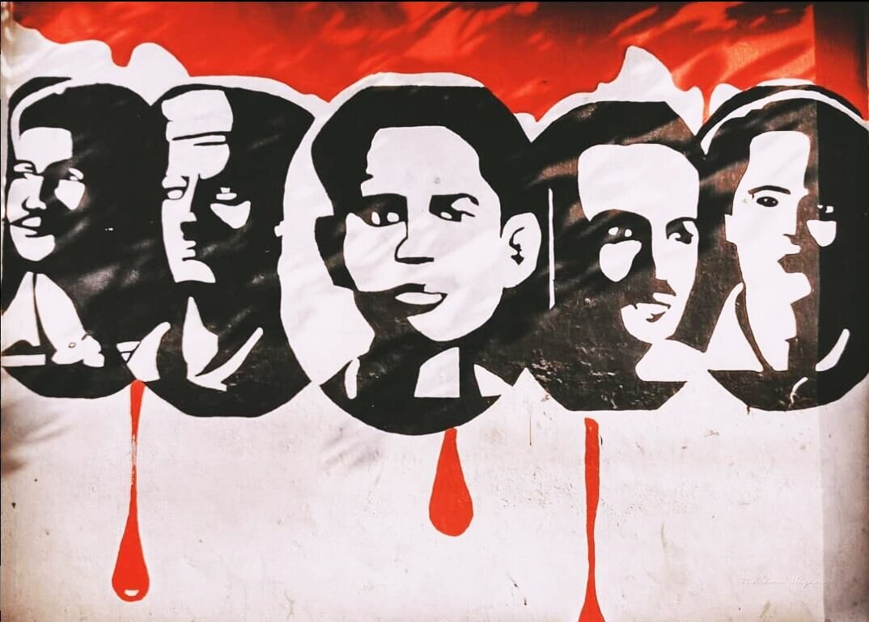
21 FEBRUARY 1952
As the news of the killings spread, disorder erupted across the city. Shops, offices and public transport were shut down and a general strike began. At the assembly, six legislators including Manoranjan Dhar, Boshonto kumar Das, Shamsuddin Ahmed and Dhirendranath Datta requested that chief minister Nurul Amin visit wounded students in hospital and that the assembly be adjourned as a sign of mourning. This motion was supported by some treasury bench members including Maulana Abdur Rashid Tarkabagish, Shorfuddin Ahmed, Shamsuddin Ahmed Khondokar and Mosihuddin Ahmed. However, Nurul Amin refused the requests.

Slide 16
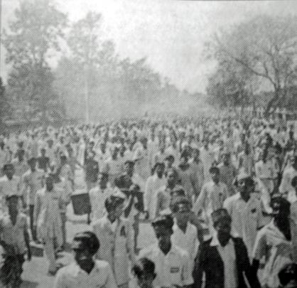
22 February 1952
Disorder spread across the province as large processions ignored section 144 and condemned the actions of the police. More than 30,000 people gathered at Curzon Hall in Dhaka. During the continued protests, police actions led to the death of four more people. This prompted officers and clerks from different organisations, including colleges, banks and the radio station, to boycott offices and join the procession. Protesters burned the offices of two leading pro-government news agencies, the Jubilee Press and the Morning News. Police fired on a major janaza, or mourning rally, as it was passing through Nawabpur Road. The shooting killed several people, including activist Sofiur Rahman and a nine-year-old boy named Ohiullah.

Slide 17
CONTINUED UNREST OF LANGUAGE MOVEMENT
Through the night of 23 February, students of Dhaka Medical College worked on the construction of a Shaheed Smritistombho, or Monument of Martyrs. Completed at dawn on 24 February, the monument had a handwritten note attached to it with the words "Shaheed Smritistombho". Inaugurated by the father of the slain activist Sofiur Rahman, the monument was destroyed on 26 February by police. On 25 February, industrial workers in the town of Narayanganj observed a general strike. A protest followed on 29 February, whose participants faced severe police beating.
The government edited news reports and withheld exact casualty figures during the protests. Most pro-government media held Hindus and communists responsible for encouraging the disorder and student unrest. The families of Abul Barkat and Rafiq Uddin Ahmed tried to charge the police with murder, but the charges were dismissed by the police. On 8 April government report on the incidents failed to show any particular justification for police firings of the students.

Slide 18
EVENTS AFTER 1952
The shorbodolio kendrio rashtrobhasha kormi porishod, with support from the awami muslim league, decided to commemorate 21 february as shohid dibosh.
On the first anniversary of the protests, people across east bengal wore black badges in solidarity with the victims. Most offices, banks and educational institutions were closed to observe the occasion. Student groups made agreements with college and police officials to preserve law and order.
More than 100,000 people assembled at a public meeting held in dhaka, where community leaders called for the immediate release of maulana bhashani and other political prisoners. However, west pakistani politicians such as fazlur rahman aggravated sectional tensions by declaring that anyone who wanted bengali to become an official language would be considered an "enemy of the state". Bengali students and civilians disobeyed the restrictions to celebrate the anniversary of the protests. Demonstrations broke out on the night of 21 february 1954, with various halls of the university of dhaka raising black flags in mourning.

Slide 19
UNITED FRONT IN 1954
Political tensions came to a head as elections to the provincial assembly of East Bengal were held in 1954. The ruling Muslim League denounced the opposition United Front coalition, which—led by A K Fazlul Huq and the Awami League—wanted greater provincial autonomy. Several United Front leaders and activists were arrested. The United Front won a vast majority of seats in the legislative assembly, while the representation of the Muslim League was reduced to a historic low.
The United Front ministry ordered the creation of the Bangla Academy to promote, develop, and preserve the Bengali language, literature, and heritage. However, the United Front rule was temporary, as Governor General Golam Mahmud cancelled the government and started Governor's rule on 30 May 1954. The United Front again formed the ministry on 6 June 1955 after the governor's regime ended.
Following the return of the United Front to power, the anniversary on 21 February 1956 was observed for the first time in a peaceful atmosphere. The Government supported a major project to construct a new Shaheed Minar. The session of the constituent assembly was stopped for five minutes to express condolence for the students slain in the police shootings. Major rallies were organised and all public offices and businesses remained closed.

Slide 20
CONSTITUTIONAL STATUS AS A STATE LANGUAGE
With the defeat of the Muslim League in the East Bengal assembly elections, the central government became flexible in recognizing Bengali as the state language of Pakistan, along with Urdu.
On 7 May 1954, the constituent assembly resolved, with the Muslim League's support, to grant official status to Bengal. Bengali was adopted as an official language of Pakistan along with Urdu in article 214(1) when the first constitution of Pakistan was enacted on 29 February 1956. Mohammad Ali Bogra raised the language-related clauses of the constitution in Parliament.
According to the clauses, the Bengali language was given equal recognition as a state language like Urdu. In Parliament and the Legislative Assembly, besides Urdu and English, there was an opportunity to speak in Bengali. The constitution also provided opportunities for higher education in Bengali.

Slide 21
CONSTITUTIONAL STATUS AS A STATE LANGUAGE
However, the military government formed by Ayub Khan made attempts to re-establish Urdu as the sole national language. On 6 January 1959, the military regime issued an official statement and reinstated the official stance of supporting the 1956 constitution's policy of two state languages.

Slide 22


